Slide 1

Fetal Health Prediction using Cardiotocography (CTG) data
Varin kala (2022561)
Soham ghosh (2022504)

Slide 2

Problem Statement and Motivation

Slide 3
A Brief Problem Review
Child and maternal mortality remain significant global challenges, particularly in low-resource settings. Addressing these issues requires accessible and effective methods to monitor fetal health during pregnancy and intervene promptly to prevent adverse outcomes. By leveraging innovative technologies and data-driven approaches, we aim to save lives by empowering healthcare providers to intervene swiftly and decisively, potentially averting countless tragedies and ensuring that more mothers and babies thrive.

Slide 4



Literature Review and Datasets

Slide 5
Literature Review
As traditional methods for interpreting and classifying Cardiotocography (CTG) data yielded unsatisfactory results, research focus shifted over the last decade toward applying computational intelligent techniques such as Neural Networks for CTG classification. Comert et al. used the CTU-UHB dataset with 552 raw CTG data points to predict the fetal state with 87.9% accuracy. In another work with the same dataset, they reported an accuracy of 91.8% and 93.4%, respectively, with an artificial neural network (ANN) and an extreme learning machine (ELM) Comert (2019). These models have shown high accuracy for normal and pathological states; however, the accuracy dropped to 59% for suspicious CTGs. Sundar et al. generated a model using XGBoost with an accuracy of 96% for the pathological state but only 73% for suspicious state. Santosh et al. released an article on soft-computing based approach on Fetal Health Classification.

Slide 6
Dataset
The dataset was imported from Kaggle and has 2126 records consisting of 21 features extracted from Cardiotocogram(CTG’s) exams, which have been classified by expert obstetricians into 3 classes: Normal, Suspect, and Pathological Cases

Slide 7
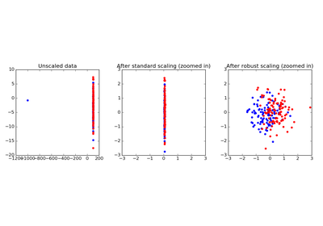
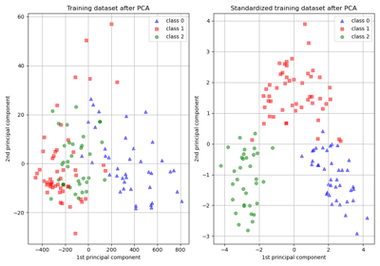
Data Preprocessing

Slide 8
Missing Values
No missing or null values were encountered in the entire dataset.

Slide 9
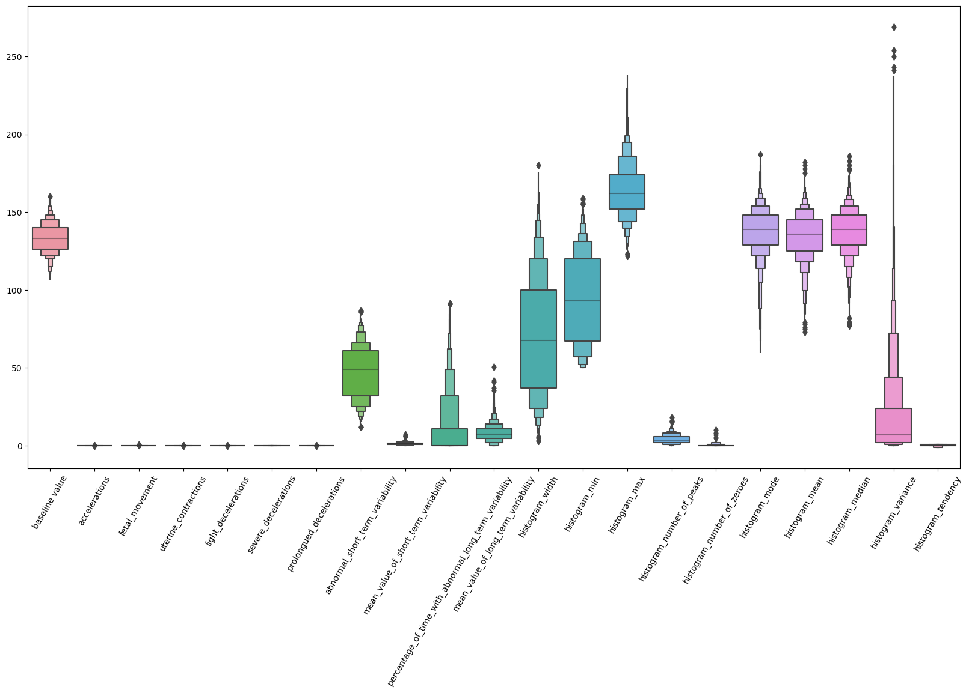
Standard Scaling
Boxplot before Standard Scaling

Slide 10
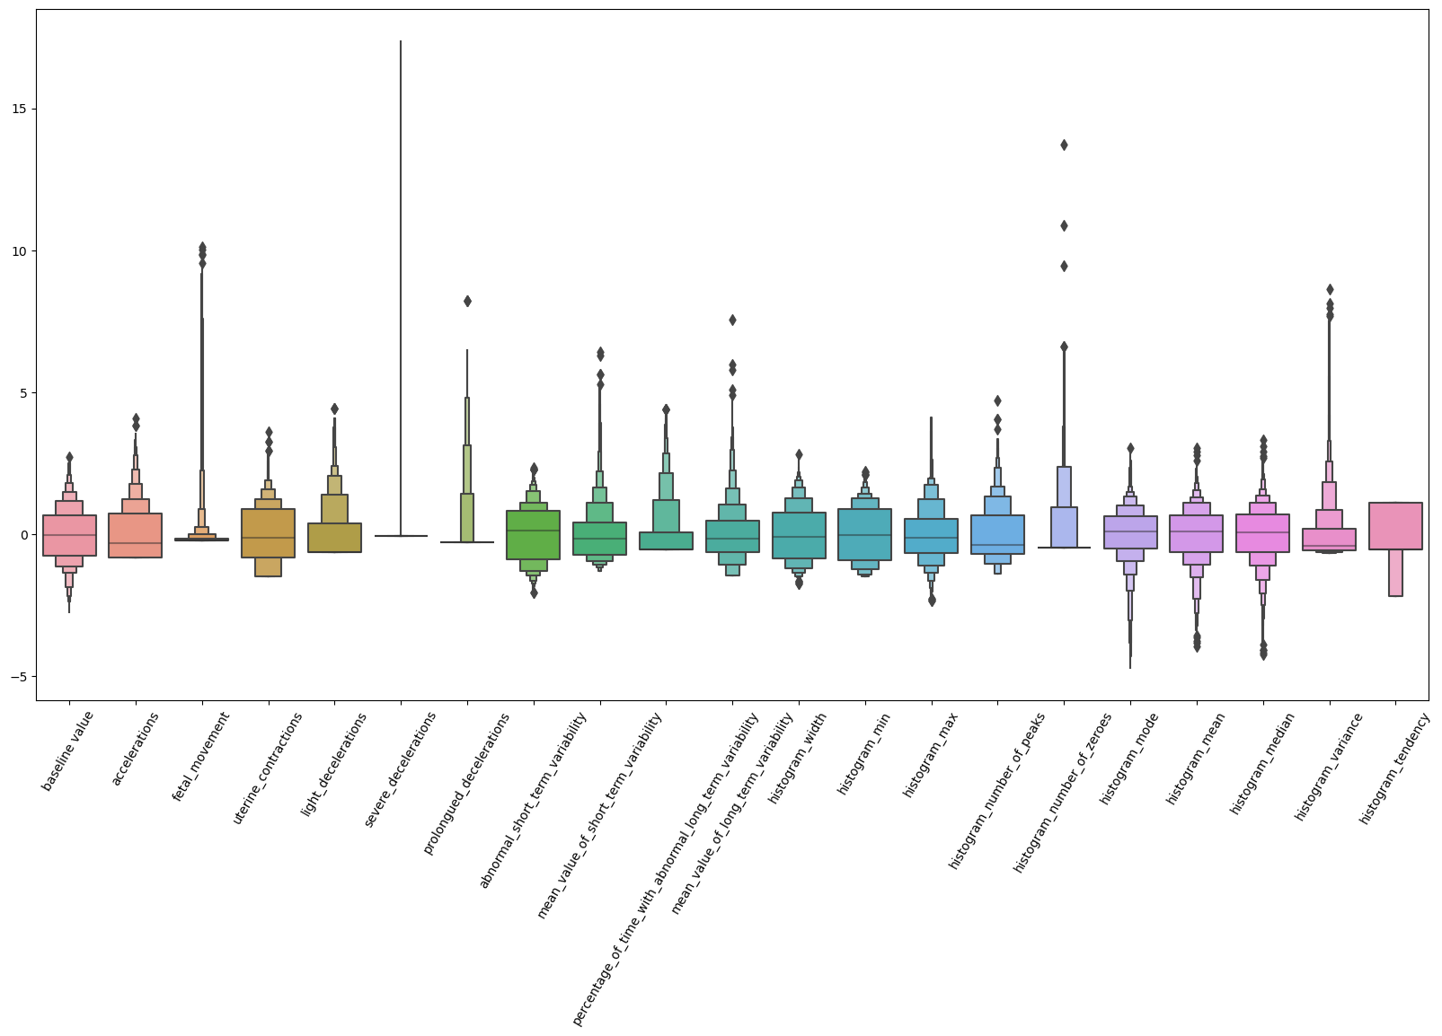
Standard Scaling
Boxplot after Standard Scaling

Slide 11
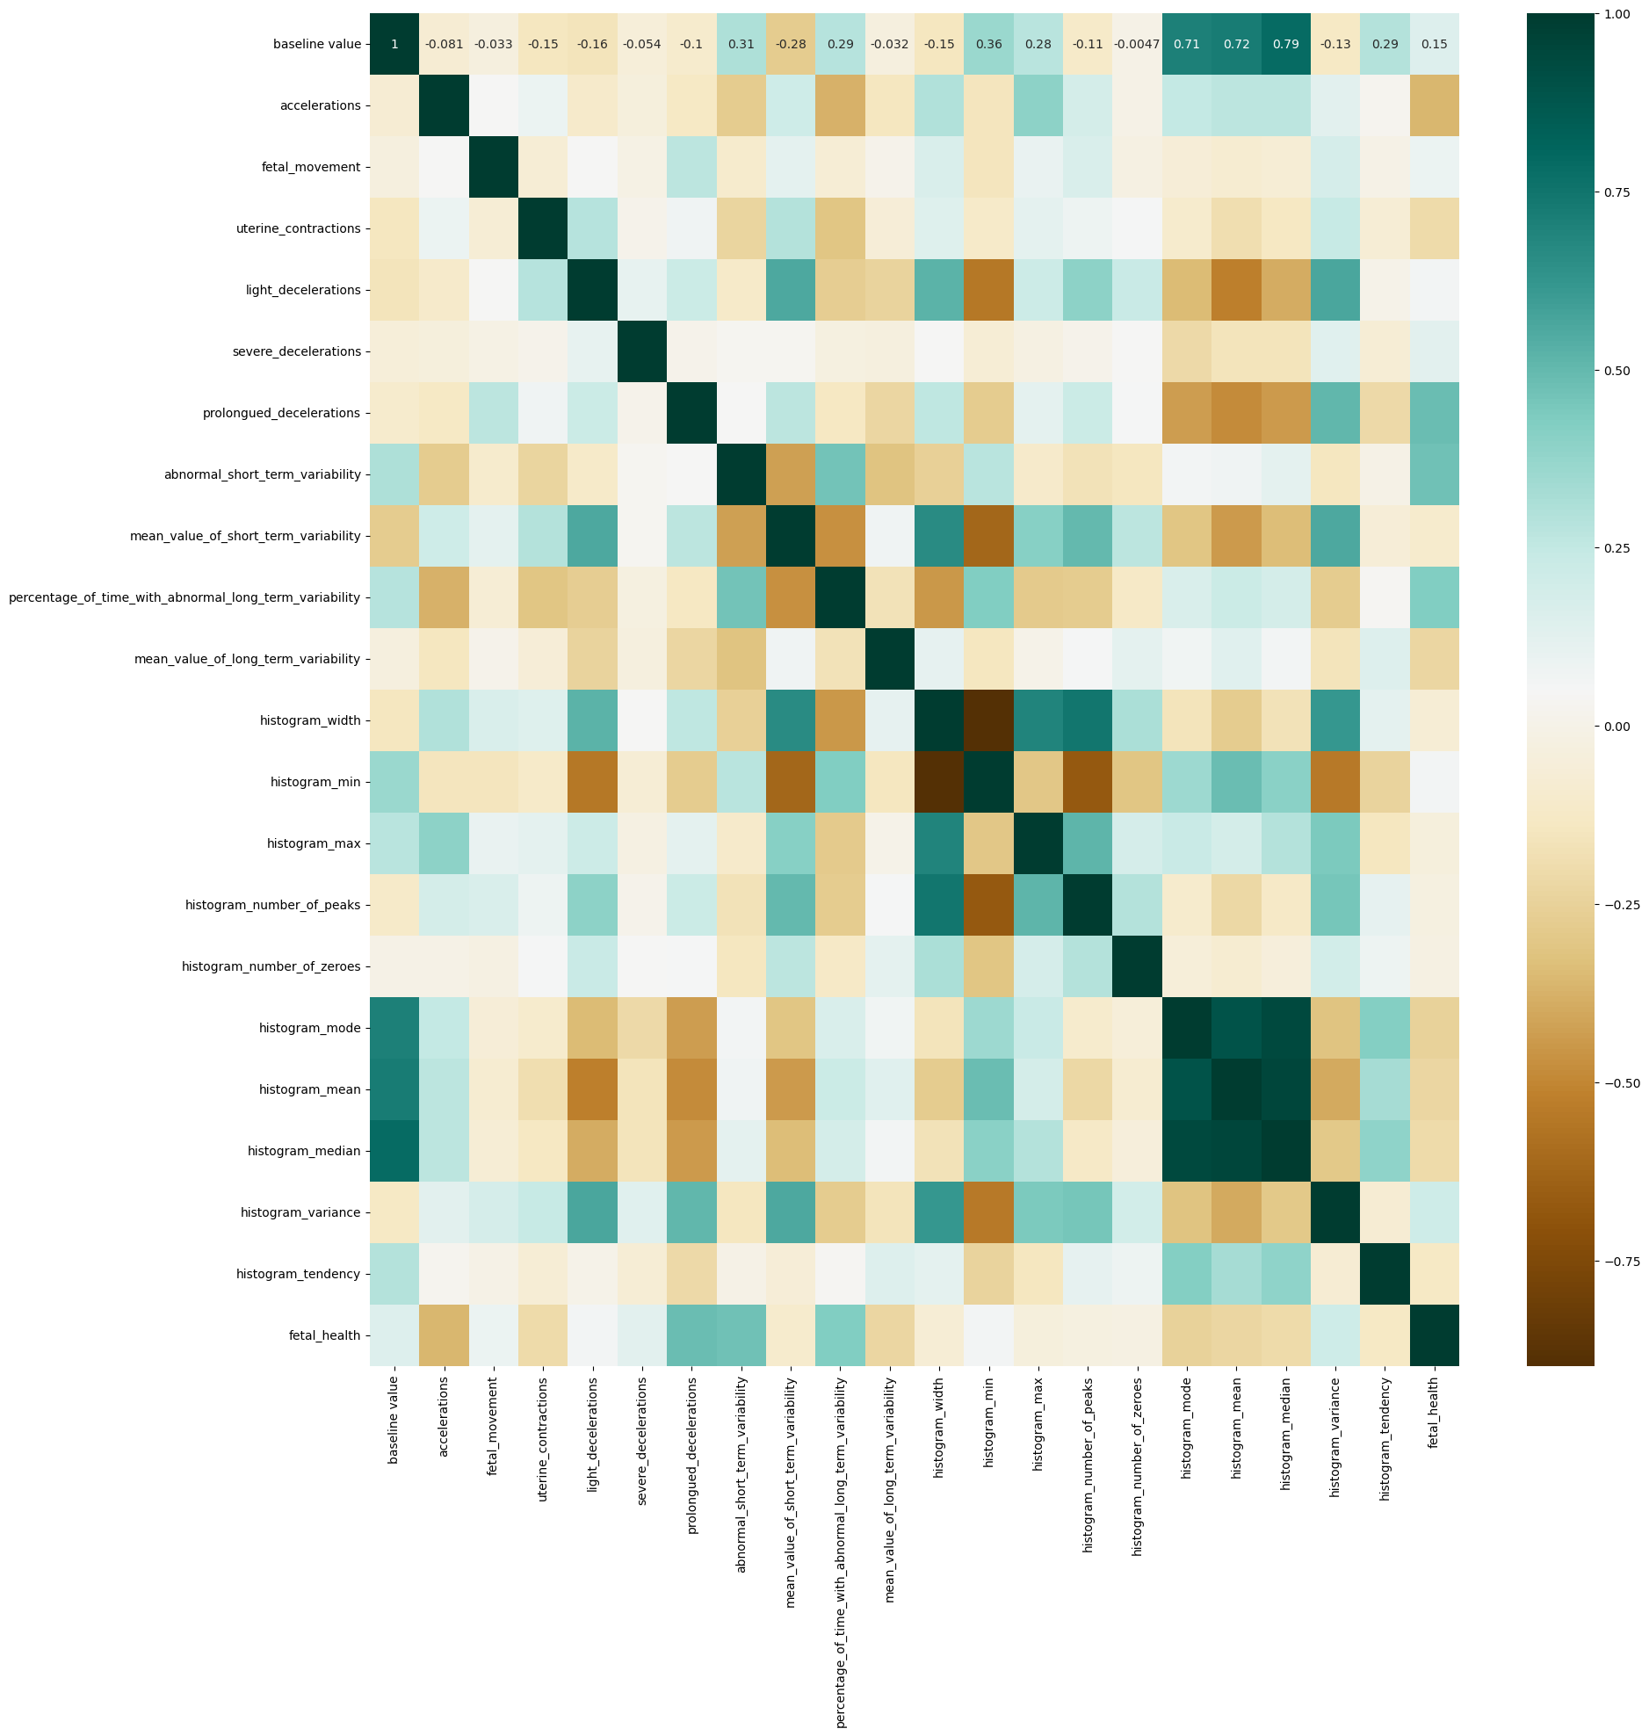
Correlation Matrix

Slide 12
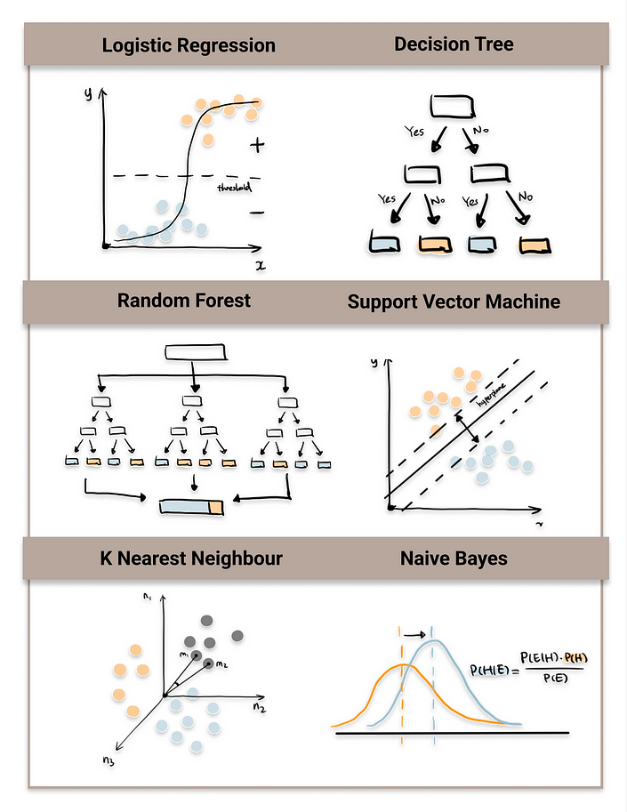
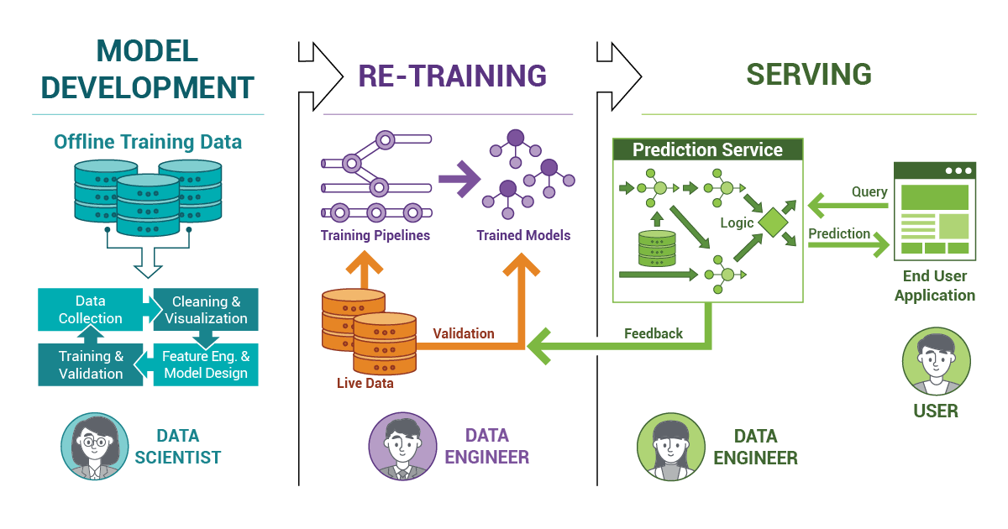
Models Used

Slide 13
Logistic Regression
Benefits:
Interpretability: Logistic regression provides easily interpretable results. The coefficients associated with each feature can be directly interpreted as the impact of that feature on the probability of the outcome.
Efficiency: Logistic regression is computationally efficient and can handle large datasets with relatively little computational overhead.
Probabilistic Output: Logistic regression outputs probabilities rather than just class labels, making it useful for tasks where understanding the likelihood of different outcomes is important.
Works Well with Linearly Separable Data: Logistic regression performs well when the classes are linearly separable or when the decision boundary can be approximated by a linear function.
Fewer Assumptions: Logistic regression has fewer assumptions compared to other classification algorithms, such as naive Bayes or decision trees. It does not require the features to be normally distributed or have equal variance.
Limitations:
Limited Expressiveness: Logistic regression assumes a linear relationship between the features and the log-odds of the outcome. It may not capture complex non-linear relationships in the data.
Sensitivity to Outliers: Logistic regression can be sensitive to outliers, especially when using maximum likelihood estimation. Outliers can disproportionately influence the estimated coefficients and affect the model's performance.
Assumption of Independence of Errors: Logistic regression assumes that errors between observations are independent of each other. Violation of this assumption, such as in time-series data or spatial data, can lead to biased parameter estimates.
Binary Classification Only: Logistic regression is primarily used for binary classification tasks. While extensions exist for multi-class classification (e.g., one-vs-rest), logistic regression may not perform as well as specialized algorithms for multi-class problems.
Requires Feature Engineering: Logistic regression relies on informative features for accurate predictions. Feature engineering is often necessary to ensure that relevant information is captured and that irrelevant features are excluded.

Slide 14
Logistic Regression
Key Features
1. Binary Classification: Logistic regression is used when the dependent variable is binary, meaning it has only two possible outcomes (e.g., yes/no, true/false, 0/1).
2. Linear Model: Like linear regression, logistic regression assumes a linear relationship between the independent variables (features) and the log-odds of the outcome. However, instead of predicting the outcome directly, logistic regression predicts the probability that the outcome is true given the input features.
3. Logistic Function (Sigmoid Function): The linear combination of input features is transformed using the logistic function, also known as the sigmoid function. This function maps any real-valued number to the range [0, 1], which is suitable for representing probabilities.
4. Maximum Likelihood Estimation (MLE): The coefficients β are estimated from the training data using maximum likelihood estimation. The goal is to maximize the likelihood function, which measures how likely it is to observe the given set of outcomes (labels) given the input features and the current parameter estimates
5. Decision Boundary: Logistic regression separates the feature space into two regions based on the decision boundary. This boundary is determined by the logistic function and can be linear or nonlinear depending on the complexity of the model.

Slide 15
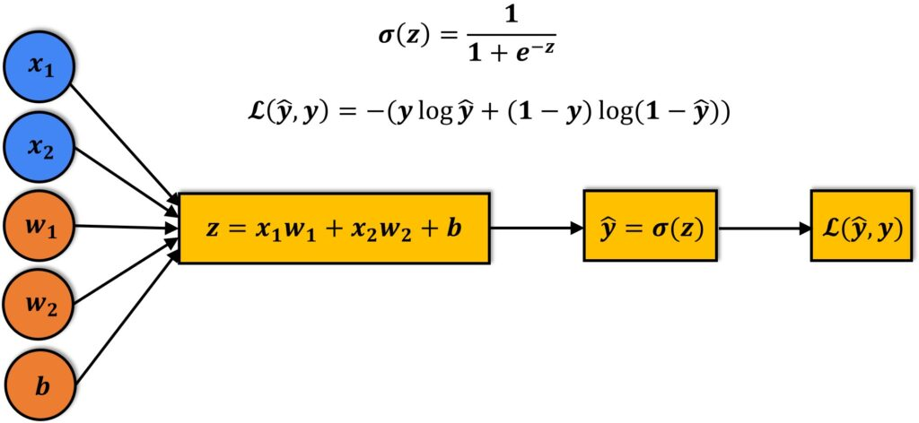
Logistic Regression

Slide 16
Gradient Boosting Classifiers
Benefits:
High Predictive Accuracy: Gradient Boosting Classifiers, often provide state-of-the-art performance in both classification and regression tasks. They excel in capturing complex relationships within the data.
Handles Mixed Data Types: Gradient Boosting can handle a variety of data types, including numerical and categorical features, without the need for extensive preprocessing. This versatility makes it suitable for a wide range of real-world datasets.
Feature Importance: Gradient Boosting algorithms provide feature importance scores, indicating the contribution of each feature to the model's predictive performance. This information can be valuable for feature selection and understanding the data.
Ensemble Learning: Gradient Boosting is an ensemble learning method that combines multiple weak learners (typically decision trees) to create a strong learner. By iteratively improving the model's predictions, it can often achieve higher accuracy than individual models.
Robustness to Overfitting: Gradient Boosting algorithms employ techniques like shrinkage (learning rate) and tree depth regularization to prevent overfitting. This allows them to generalize well to unseen data and handle noisy datasets effectively.
Limitations:
Computational Complexity: Gradient Boosting algorithms, especially when using deep trees or large datasets, can be computationally intensive and time-consuming to train. This complexity increases with the number of iterations and the depth of the trees.
Hyperparameter Tuning: Gradient Boosting models have several hyperparameters that require tuning, such as the learning rate, tree depth, and regularization parameters. Finding the optimal combination of hyperparameters can be challenging and may require extensive experimentation.
Risk of Overfitting: While Gradient Boosting algorithms are robust to overfitting compared to some other models, they can still overfit if hyperparameters are not properly tuned or if the dataset is small or noisy.
Limited Interpretability: Similar to Random Forests, Gradient Boosting models are often considered black-box models, as they provide decision boundaries without offering insights into the underlying data relationships. Understanding individual predictions can be challenging.
Potential for Bias: Gradient Boosting models can be prone to bias towards dominant classes in imbalanced datasets, similar to Random Forests. Techniques like class weighting or resampling may be necessary to address this issue.

Slide 17
Gradient Boosting Classifiers
Key Features
1. Initialize Model: Initialize the gradient boosting model with hyperparameters such as the learning rate, number of trees (boosting rounds), tree depth, and regularization parameters. These hyperparameters may vary depending on the chosen algorithm.
2. Train Model: Train the gradient boosting model on the training data. The model learns iteratively by minimizing a loss function using gradient descent. At each iteration, a new weak learner (decision tree) is added to the ensemble to correct the errors made by the previous learners.
3. Tune Hyperparameters: Fine-tune the hyperparameters of the model using techniques such as grid search, random search, or Bayesian optimization. This step helps optimize the performance of the model and prevent overfitting.
4. Evaluate Model: Evaluate the trained model on the testing data using appropriate evaluation metrics such as accuracy, precision, recall, F1-score, and ROC-AUC. This step helps assess the generalization performance of the model on unseen data.

Slide 18
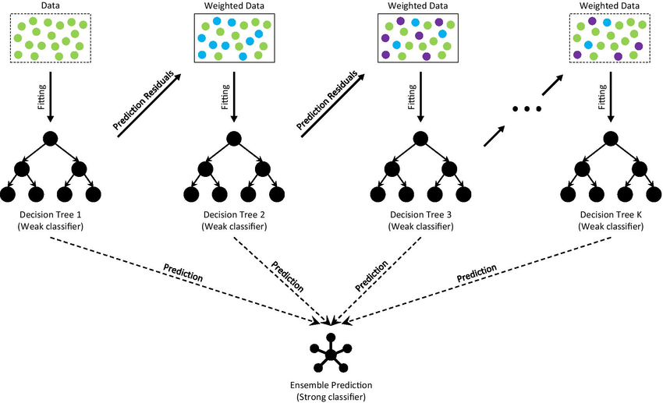
Gradient Boosting Classifiers

Slide 19
Random Forest
Benefits:
High Accuracy: Random Forests generally provide high accuracy in both classification and regression tasks. They are robust to noise and overfitting, making them suitable for a wide range of datasets.
Handles Missing Values and Outliers: Random Forests can handle missing values and outliers in the data without preprocessing. They use averaging techniques to mitigate the impact of missing values and make predictions based on multiple decision trees.
Feature Importance: Random Forests provide a feature importance score, indicating the contribution of each feature to the model's predictive performance. This information helps in feature selection and understanding the underlying data relationships.
Versatility: Random Forests can handle various types of data, including numerical and categorical features. They are also capable of handling imbalanced datasets without the need for additional sampling techniques.
Scalability: Random Forests can be parallelized and distributed across multiple processors, making them scalable for large datasets. They can handle high-dimensional data efficiently without significant computational overhead.
Limitations:
Lack of Interpretability: Random Forests are often considered black-box models, as they provide decision boundaries without offering insights into the underlying data relationships. Understanding the rationale behind individual predictions can be challenging.
Memory and Computational Resources: Random Forests store multiple decision trees in memory, which can be memory-intensive for large ensembles or datasets with many features. Training and evaluating Random Forests can also be computationally expensive, especially for large datasets.
Parameter Tuning: Random Forests have several hyperparameters that need to be tuned for optimal performance, such as the number of trees, tree depth, and the number of features considered at each split. Finding the optimal hyperparameters can require extensive experimentation and computational resources.
Bias Towards Dominant Classes: In classification tasks with imbalanced datasets, Random Forests may exhibit a bias towards dominant classes, leading to suboptimal performance for minority classes. Techniques such as class weighting or resampling can help mitigate this issue.
Non-Linear Relationships: While Random Forests can capture complex non-linear relationships in the data, they may struggle with capturing intricate interactions between features compared to more sophisticated models like gradient boosting or neural networks.

Slide 20
Random Forest
Key Features
1. Ensemble Learning: Random forests combine multiple decision trees to make predictions. Each decision tree is built independently using a random subset of the training data and features.
2. Bootstrap Aggregating (Bagging): Random forests use a technique called bootstrap aggregating to create diverse sets of training data for each decision tree. This involves randomly sampling the training data with replacement to create multiple subsets.
3. Random Feature Selection: At each node of the decision tree, only a random subset of features is considered for splitting. This randomness helps prevent overfitting and promotes model diversity.
4. Decision Tree Construction: Each decision tree is constructed recursively by splitting nodes based on the best feature and split criterion (e.g., Gini impurity for classification, mean squared error for regression).
5. Voting or Averaging: For classification tasks, the final prediction is made by a majority vote among the individual trees. For regression tasks, predictions are averaged across all trees.

Slide 21
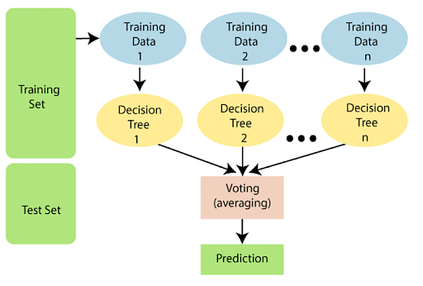
Random Forest

Slide 22
KNN
Benefits:
Non-Parametric: KNN is a non-parametric algorithm, meaning it does not make any assumptions about the underlying data distribution. This flexibility allows it to perform well on a wide range of datasets.
No Training Phase: KNN does not have a training phase; instead, it memorizes the training data. This makes it efficient for online learning scenarios where new data points are continuously added.
Effective for Multimodal Data: KNN can capture complex decision boundaries and handle multimodal data effectively, making it suitable for tasks where the classes are not linearly separable.
Versatility in Classification and Regression: KNN can be used for both classification and regression tasks, providing predictions based on the majority class or the average of the nearest neighbors' target values.
Limitation
Computational Complexity: KNN requires computing distances between the query instance and all training instances, which can be computationally expensive, especially for large datasets and high-dimensional feature spaces.
Memory Intensive: KNN stores the entire training dataset in memory, which can be memory-intensive for large datasets with many features or instances.
Sensitive to Noise and Outliers: KNN's performance can be sensitive to noisy or irrelevant features, as well as outliers in the data, which can affect the accuracy of predictions.
Requires Feature Scaling: Since KNN relies on distance metrics, it is essential to scale the features to have a similar range. Failure to do so can lead to biased results, where features with larger scales dominate the distance calculation.
Need to Tune Hyperparameter k: The choice of the number of neighbors (k) in KNN can significantly impact the model's performance. Selecting an optimal value for k requires experimentation and domain knowledge.s:

Slide 23
KNN
Key Features
1. Instance-Based Learning: KNN is an instance-based learning algorithm used for both classification and regression tasks. It does not explicitly learn a model but instead stores all training instances and makes predictions based on their similarity to new instances.
2. Distance Metric: KNN relies on a distance metric (e.g., Euclidean distance, Manhattan distance) to measure the similarity between instances in the feature space. The choice of distance metric depends on the nature of the data and the problem at hand.
3. Parameter k: The "k" in KNN refers to the number of nearest neighbors considered when making predictions. A higher value of k considers more neighbors, leading to smoother decision boundaries but potentially sacrificing local detail.
4. Prediction: For classification tasks, the predicted class of a new instance is determined by majority voting among its k nearest neighbors. For regression tasks, the predicted value is the average (or weighted average) of the target values of the k nearest neighbors.

Slide 24
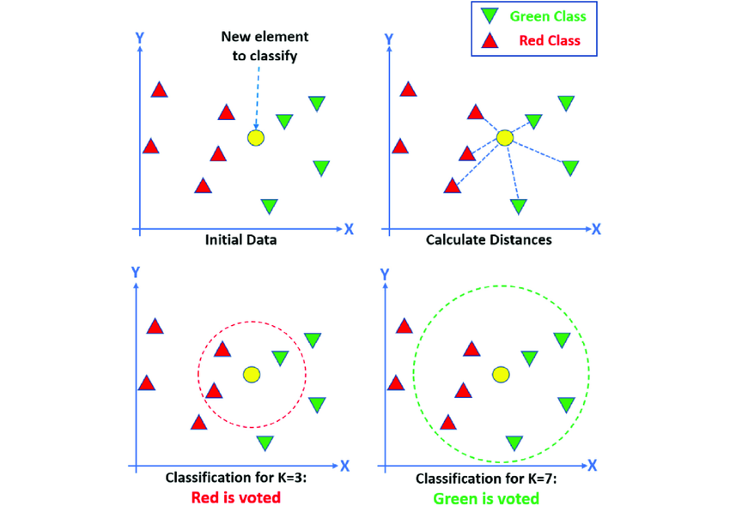
KNN

Slide 25
SVM
Benefits:
Effective in High-Dimensional Spaces: SVM performs well even in high-dimensional spaces, making it suitable for tasks with many features, such as text classification and gene expression analysis.
Robustness to Overfitting: SVMs have a regularization parameter (C) that helps prevent overfitting by controlling the trade-off between maximizing the margin and minimizing the classification error.
Versatility with Kernel Methods: SVMs can handle both linearly separable and non-linearly separable data using kernel functions. This flexibility allows for the modeling of complex decision boundaries.
Maximization of Margin: SVMs aim to maximize the margin between classes, which can lead to better generalization performance on unseen data and make the model less sensitive to outliers.
Global Optimality: SVMs aim to find the optimal hyperplane that separates the classes, which often leads to a unique solution and ensures global optimality.
Limitations:
Sensitivity to Parameters: SVM performance can be sensitive to the choice of parameters, such as the choice of kernel function and regularization parameter. Tuning these parameters can be time-consuming and requires domain knowledge.
Computational Complexity: Training SVMs can be computationally intensive, especially for large datasets, as it involves solving a quadratic programming problem. Additionally, the prediction time can be relatively slow, especially when using non-linear kernels.
Memory Intensive: SVMs store all support vectors in memory, which can be memory-intensive, especially for large datasets with many support vectors.
Limited Interpretability: SVMs provide decision boundaries but do not offer direct insights into the relationships between features and the target variable. They are often considered black-box models.
Difficulty with Large Datasets: SVMs may not scale well to very large datasets due to their computational complexity and memory requirements. In such cases, simpler models or dimensionality reduction techniques may be more appropriate.

Slide 26
SVM
Key Features
1. Linear Separability: SVM is a supervised learning algorithm used for classification tasks. It aims to find the optimal hyperplane that best separates the data into different classes. If the data is not linearly separable in the original feature space, SVM can map it to a higher-dimensional space where separation is possible.
2. Maximizing Margin: SVM seeks to maximize the margin, which is the distance between the hyperplane and the nearest data points (support vectors) of each class. By maximizing the margin, SVM aims to achieve better generalization performance on unseen data.
3. Kernel Trick: SVM can efficiently handle non-linearly separable data by using the kernel trick. Kernels transform the input features into a higher-dimensional space, allowing for nonlinear decision boundaries to be represented as hyperplanes.
4. Regularization Parameter (C): SVM has a regularization parameter (C) that controls the trade-off between maximizing the margin and minimizing the classification error. A smaller value of C leads to a larger margin but may allow more misclassifications, while a larger value of C may result in a smaller margin but fewer misclassifications.
5. Kernel Functions: Common kernel functions include linear, polynomial, radial basis function (RBF), and sigmoid. The choice of kernel function depends on the data and the complexity of the decision boundary required.
6. Support Vectors: Support vectors are the data points that lie closest to the decision boundary. They are crucial in defining the hyperplane and are used to make predictions.

Slide 27
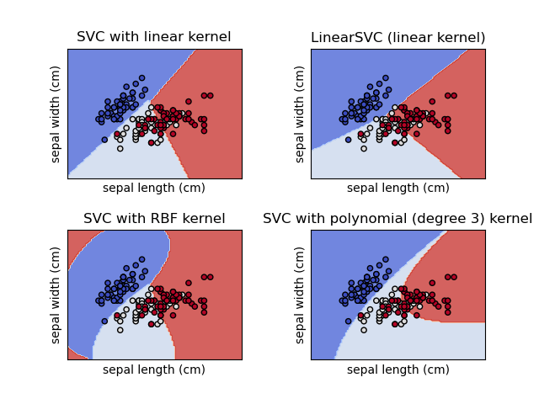
SVM

Slide 28
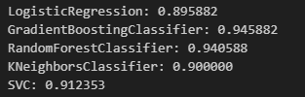
Model-wise Accuracies

Slide 29
Thank You

